Slide 1
Master Thesis Colloquium
Demand Forecast of Vytal in Cologne:
Correlation and Time Series Analysis of the Transactions
Master of Science
In Information Engineering and Computer Science
By
Kültigin Bozdemir
24205
Supervised by:
Prof. Dr. Agatha Kalhoff
Alexander Niclas Popovic

Slide 2
Outline
Introduction
Data visualization
Association analysis
Spatial autocorrelation
Correlation analysis
Forecasting
Conclusion

Slide 3
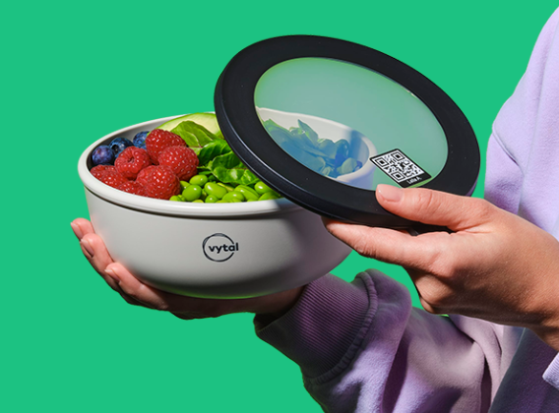
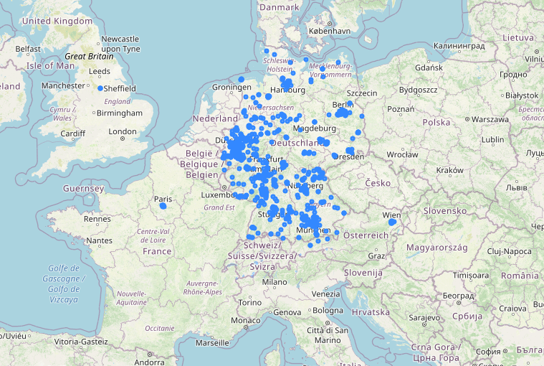
Vytal
Source: www.vytal.org
Vytal’s partners as of March 2022

Slide 4


Problem
The food containers are circulating between customers and partner stores. They need to be rebalanced to meet the demand at the individual stores.
?
Geospatial complexity
Time complexity
?
D+0
Stock
D+10
D+4

Slide 5
Aim of the thesis
This thesis aims to develop a demand prediction model for Vytal such that this prediction helps the rebalancing effort across the stores in Cologne.

Slide 6
Potential variables
Internal dependencies
Association analysis
Spatial autocorrelation
Interaction between check-ins and check-outs
Then the external factors
weather temperature,
stores' proximity to public transport stations,
proximity to green fields,
proximity to event places,
corona cases.
Notes:
Mention also data sources

Slide 7
Limitations
Geospatial area: Cologne
Time domain: Daily aggregate transactions
Container type 1 (except association analysis)
Regular consumers (non internal users, non catering users)

Slide 8
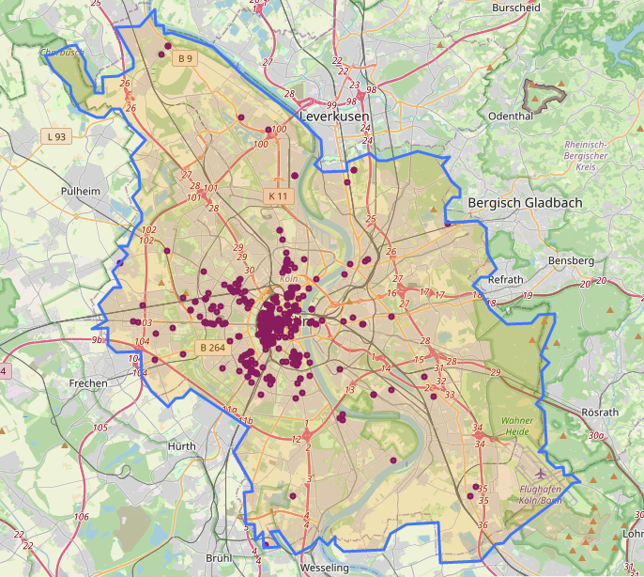
Partner stores in Cologne
350+ stores as of March 2022!
Notes:
As I mentioned, the problem has two two dimensional complexity. Spatial and time…
Regarding geospatial complexity

Slide 9
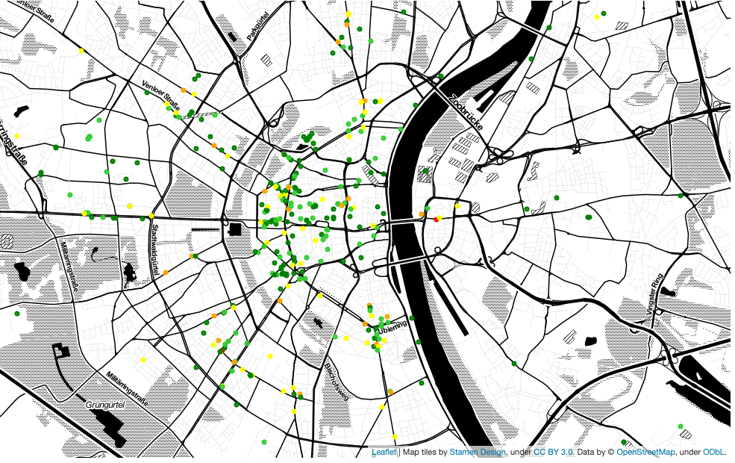
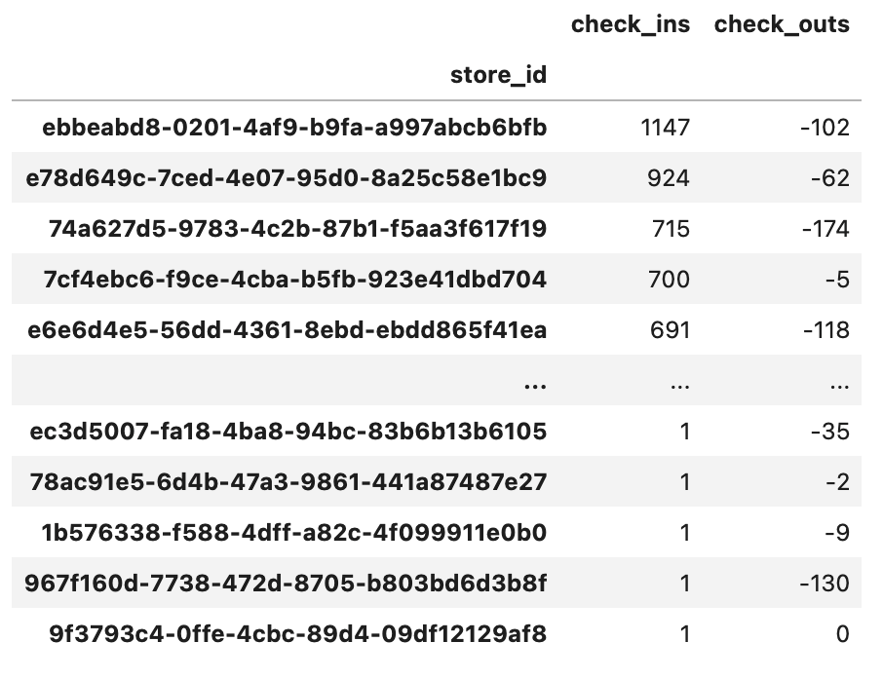
Circulation of the containers
Geospatial complexity!
Notes:
Table shows the total check-ins and check-outs.
Map shows values for each store. Red indicates the sink stores.
Green represent the stores that have more check-ins than their check-outs.

Slide 10
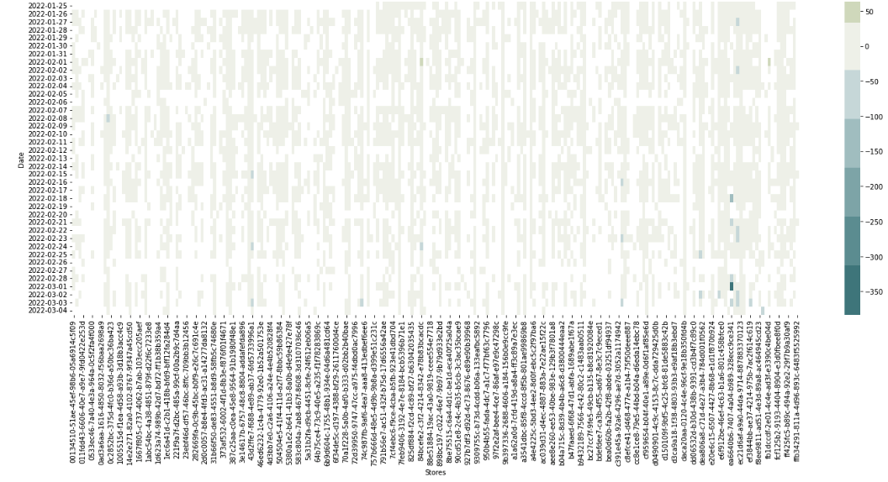
Balance of the stores in recent days
Notes:
Heatmap for recent days.
Rows show the date and columns show the stores, colors show the sum of in-out transactions.

Slide 11
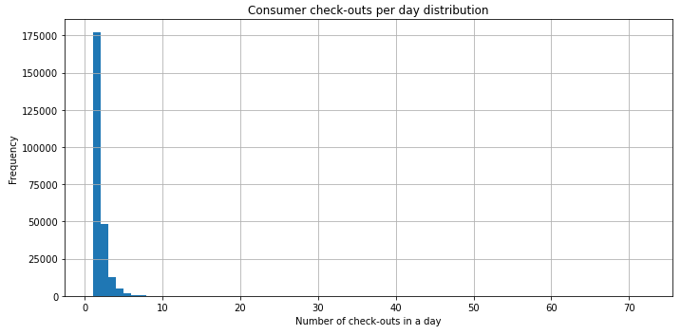
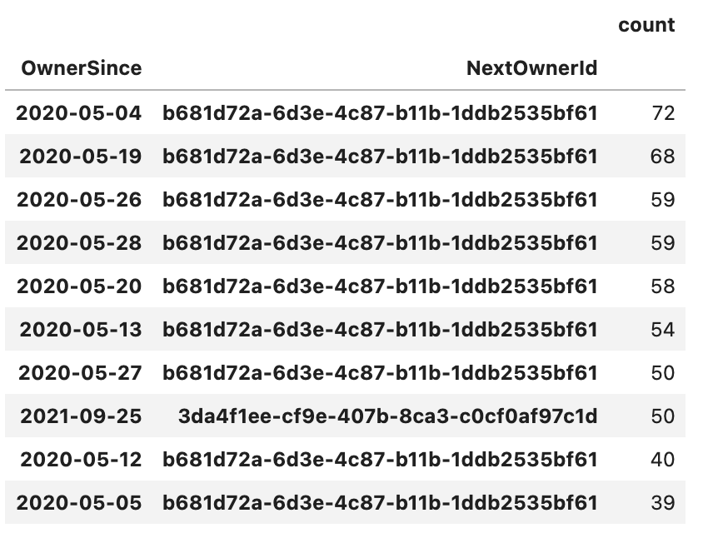
Consumer daily check-out distribution per store
Consumers>5 are removed as assumed that they are not normal users.

Slide 12
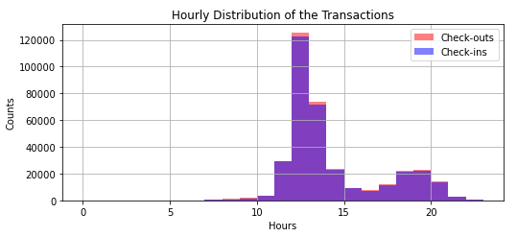
Hourly transactions distribution
Rush hours should be satisfied!
Notes:
Rush hours are noon.
Make those container available in advance.
We do not know the internal processes of the stores regarding cleaning of the containers.
Worst case: Containers will be

Slide 13
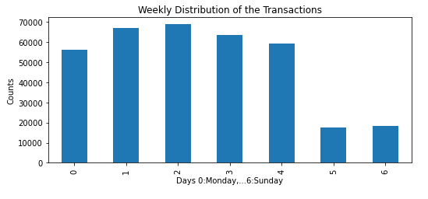
Weekly distribution

Slide 14
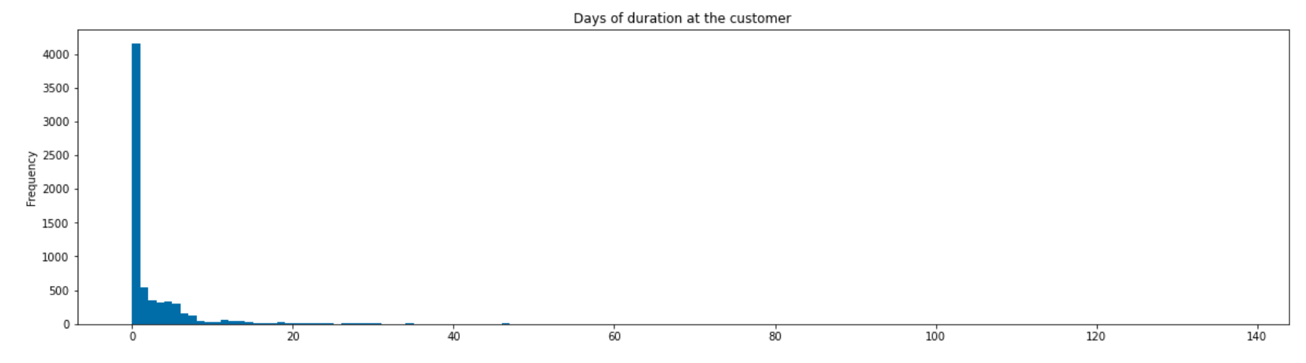
Days of the containers’ duration at customers at a store (Store id='791b56e7-ac51-432f-b75d-17d6556a42ae’)
Time complexity:
Is he going to return tomorrow , next Tuesday ? When?
How many containers will be returned today?
Notes:
Regarding time complexity:
Is he going to return tomorrow , next Tuesday ? When?

Slide 15
Internal dependencies
Association analysis
Spatial autocorrelation
Check-ins <> Check-outs interaction (last chapter)

Slide 16
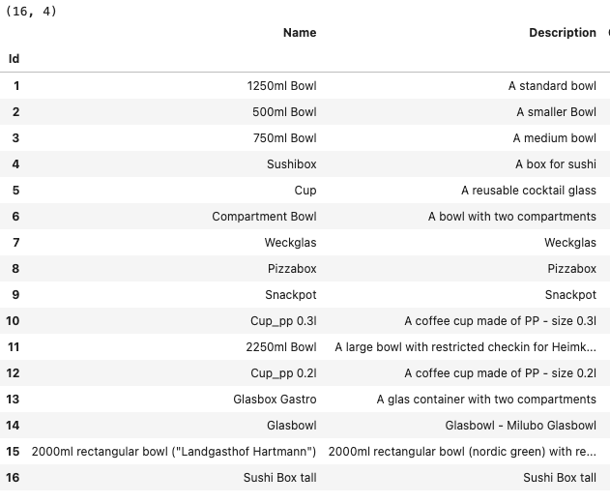
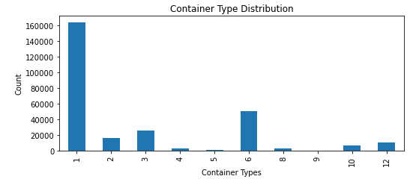
Container type distribution

Slide 17
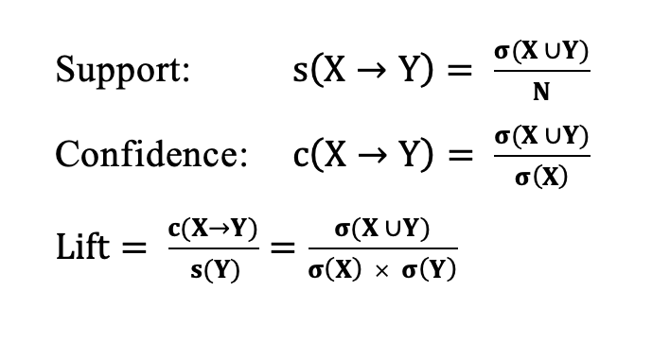
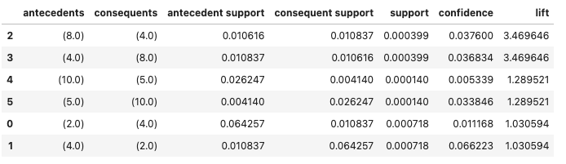
Association analysis
(Tan, Steinbach, Karpatne, & Kumar, 2020, S. 214)

Slide 18
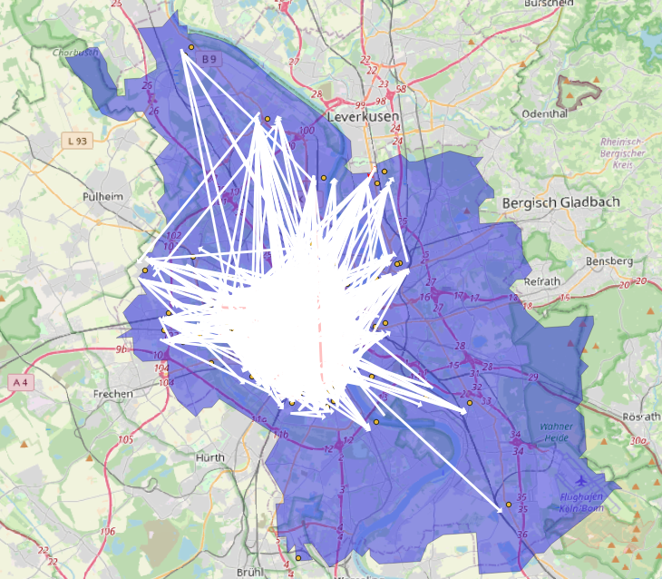
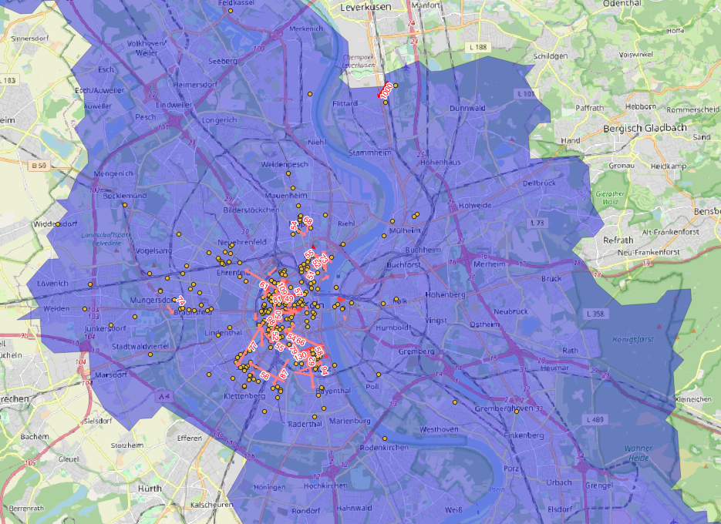
Spatial complexity Container flows among the stores

Slide 19
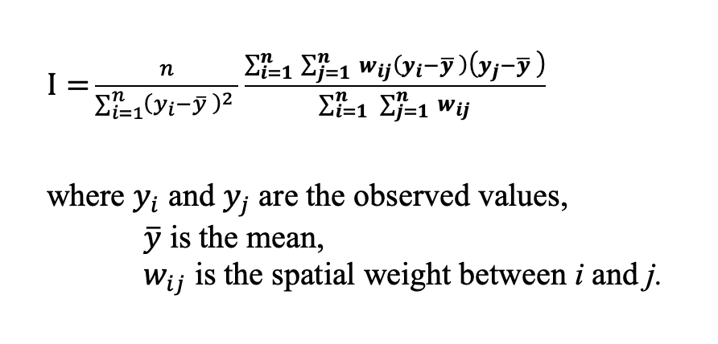
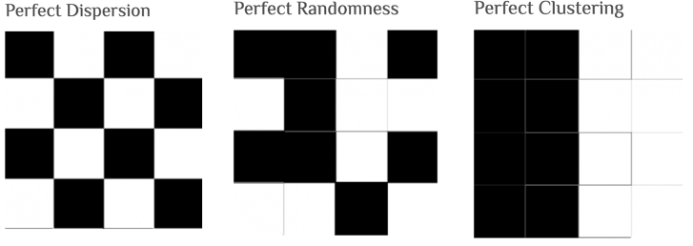
Spatial autocorrelation Moran’s I
(Source:Glen, 2016)
(rspatial.org, 2022)

Slide 20
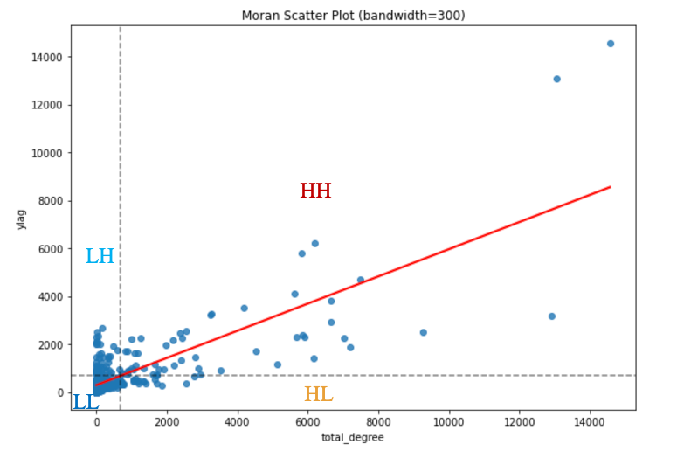
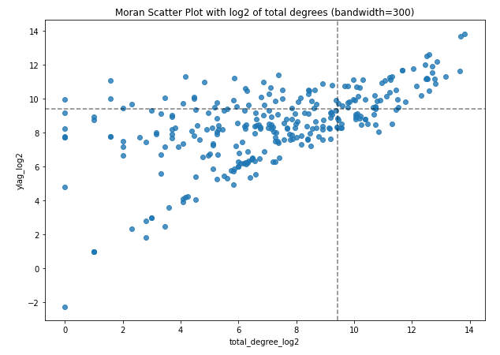
Moran’s I scatter plot

Slide 21
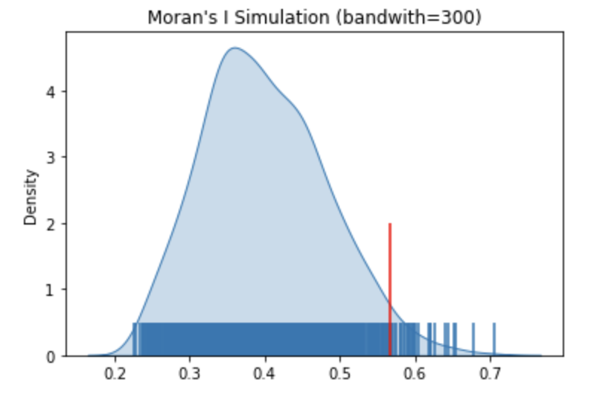
Moran’s I simulation

Slide 22
Moran’s I with different distances
Bandwidth (m) | Moran’s I | p-value
200 | 0.66 | 0.054
300 | 0.57 | 0.035
400 | 0.47 | 0.07
500 | 0.39 | 0.093
600 | 0.33 | 0.14
700 | 0.28 | 0.16
Notes:
Only Radius of 300 m shows a significant p-value.

Slide 23
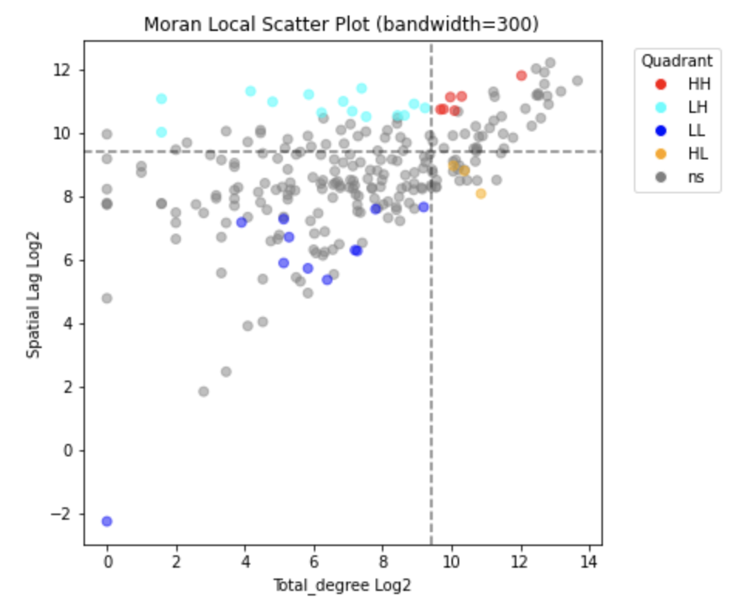
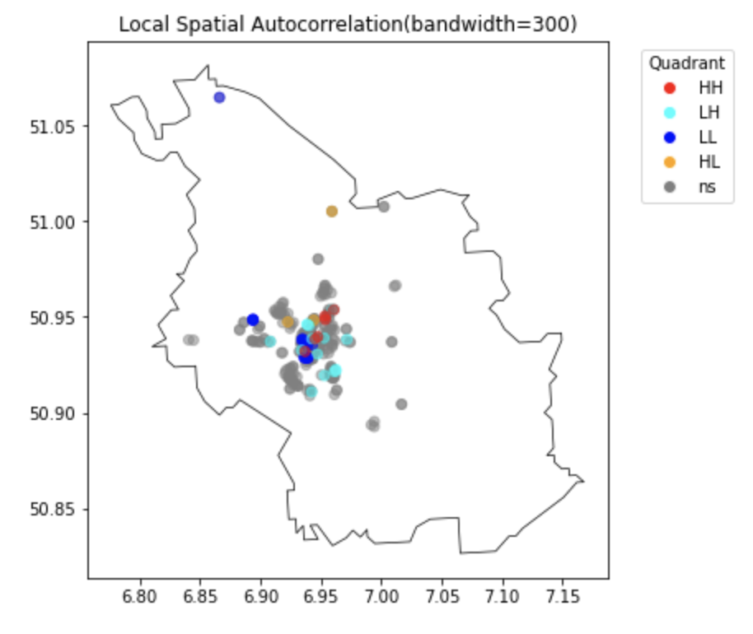
Local autocorrelation
Notes:
Ns stands for insignificant p-values.
Although global autocorrelation indicates a correlation, local autocorrelation does not.
I would accept my hypothesis if I had seen more red points on the chart right and a dense cluster of red points on the map left.
Existence of cyan, orange and blue points contradicts my hypothesis.

Slide 24
External variables
Weather temperature
Closeness to public transport (bus/train) stations
Closeness to green fields
Closeness to events
Corona cases

Slide 25
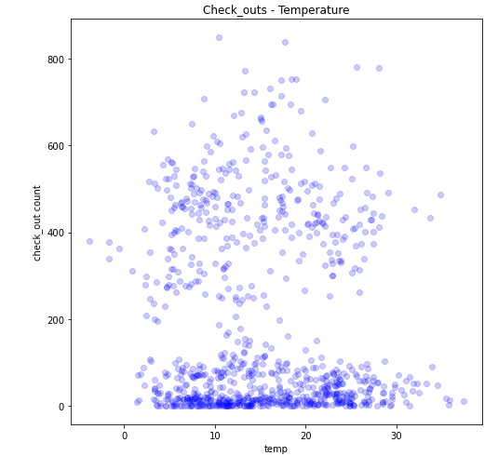
Temperature

Slide 26
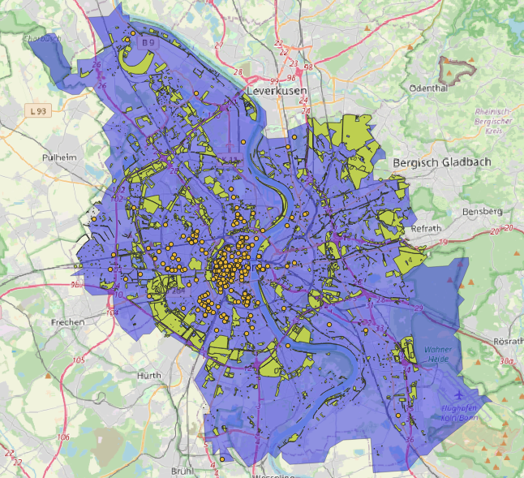
Green fields

Slide 27
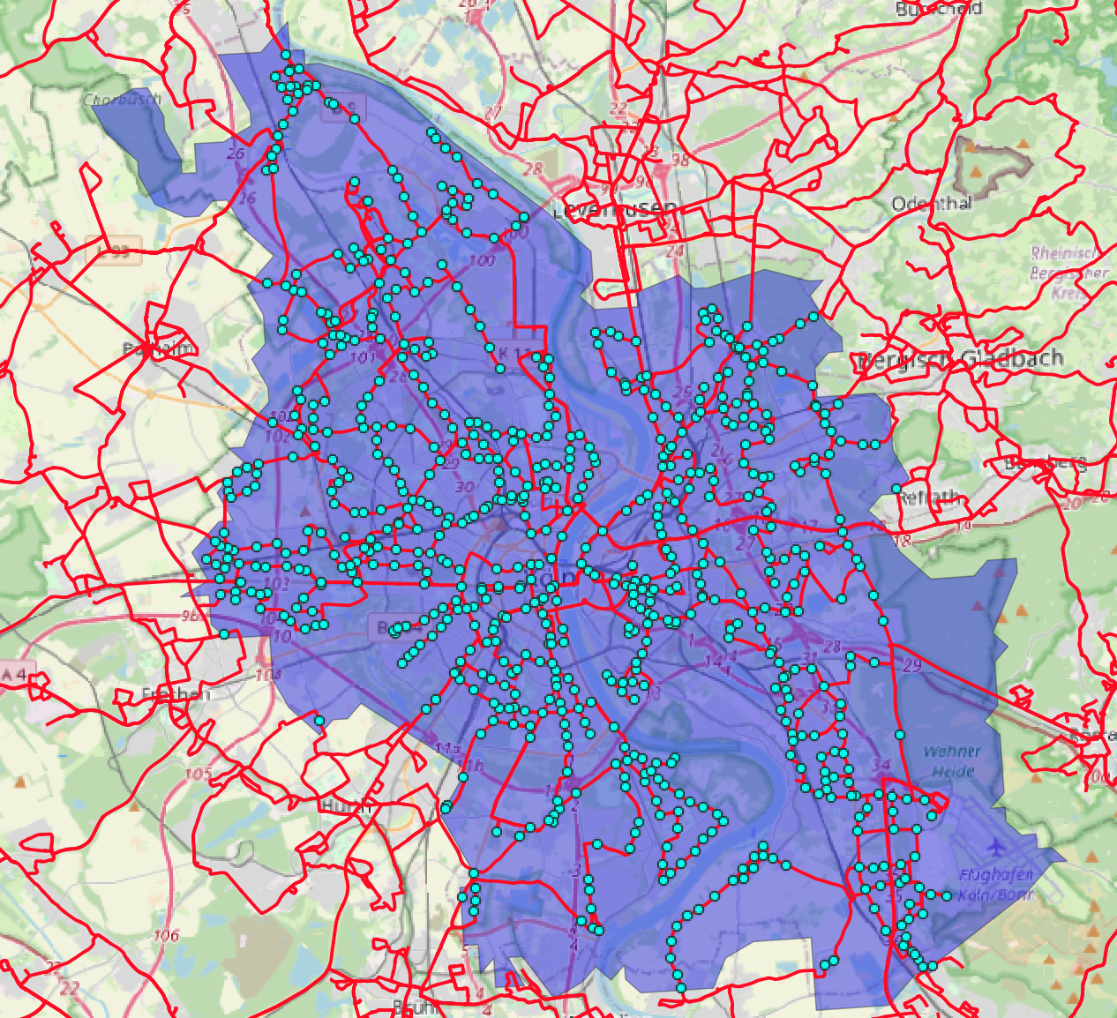
Bus network

Slide 28
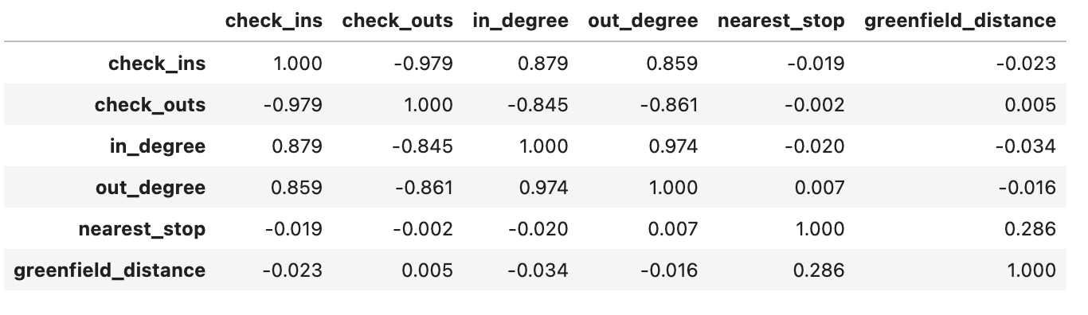
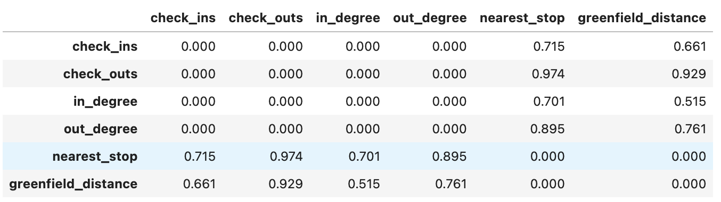
Correlation and p-values tables
Correlation Table
P-values Table

Slide 29
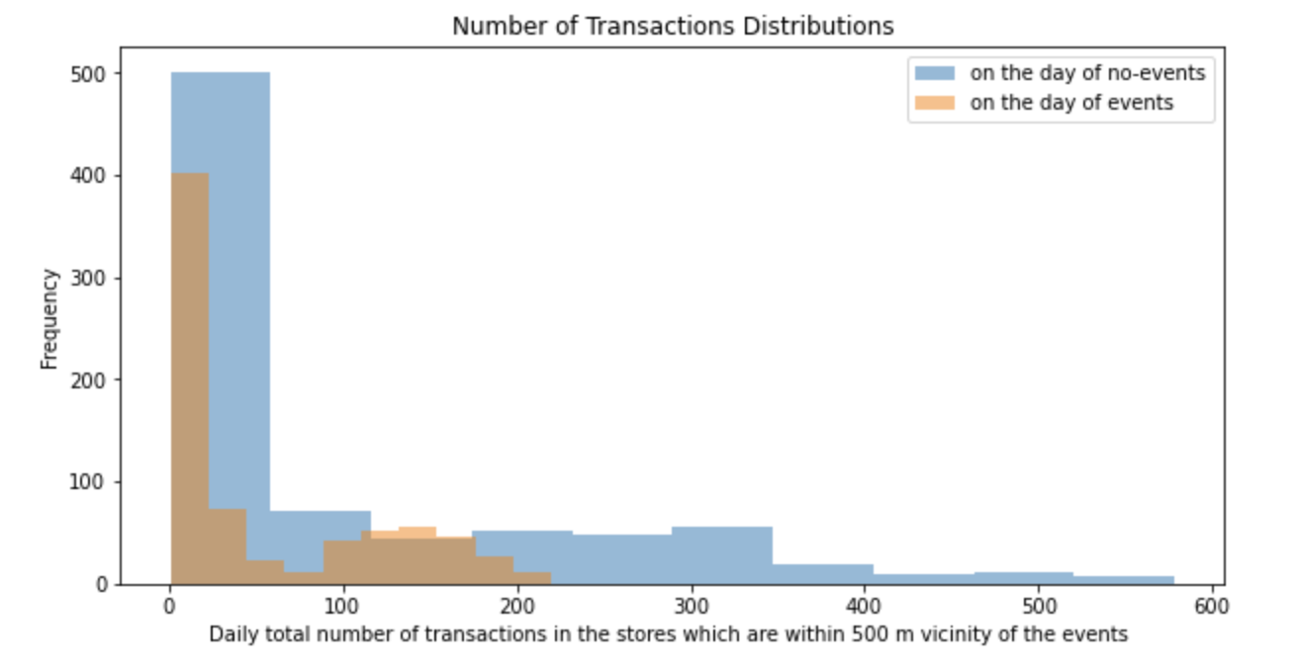
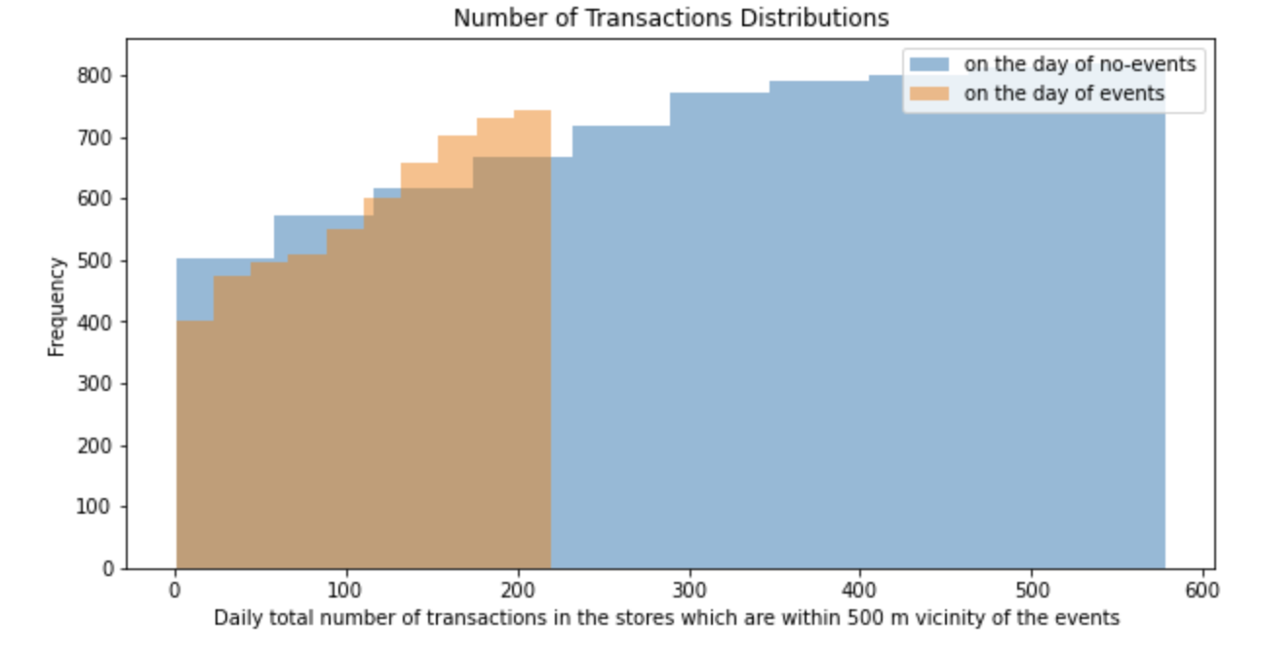
Events

Slide 30
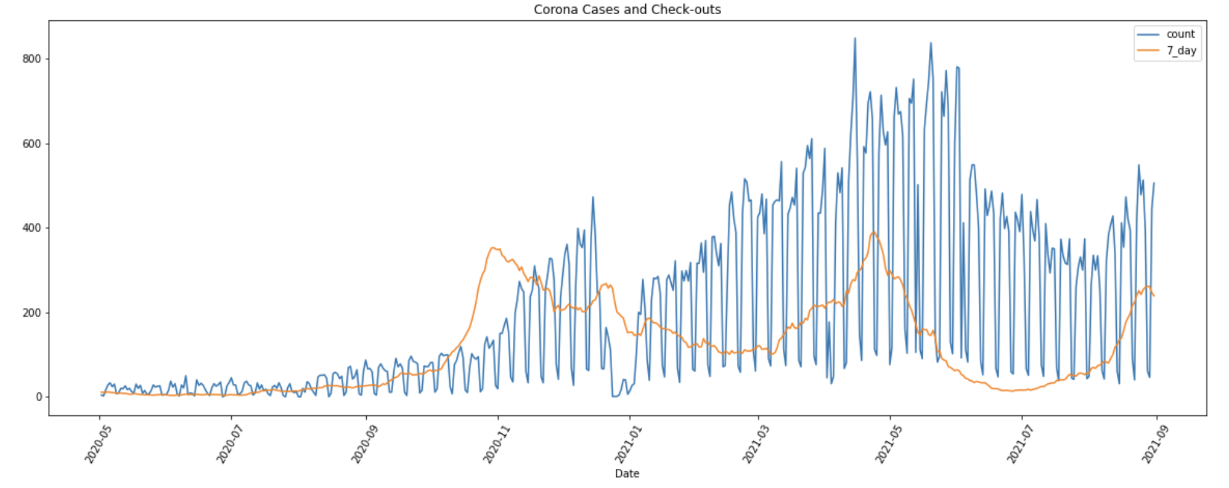
Corona cases

Slide 31
Time Series
Cologne global demand prediction analysis with ARIMA
Individual store’s demand prediction analysis with Facebook Prophet

Slide 32
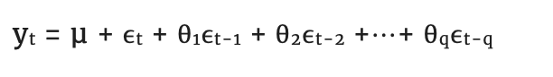
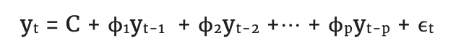
Time series analysis ARIMA
Moving average
Autoregressive
(Peixeiro, 2022, p. 68, p.91)
The basic ARIMA model is denoted by three parameters; ARIMA (p, d, q).
p= order of autoregressive part,
d= degree of differencing,
q=order of moving average part.

Slide 33
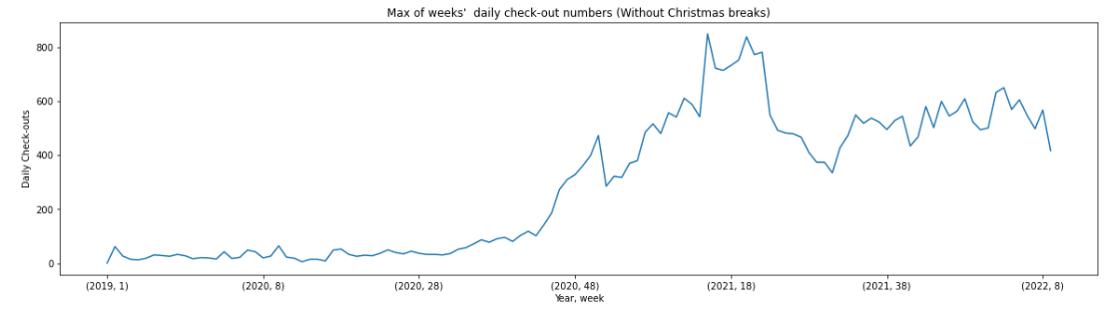
Time series analysis Data preparation for weekly demand

Slide 34
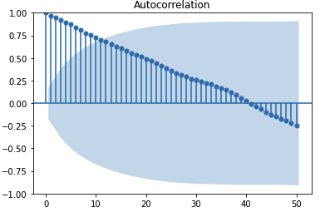
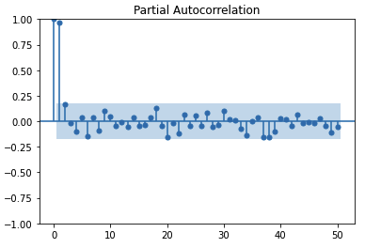
Autocorrelation

Slide 35
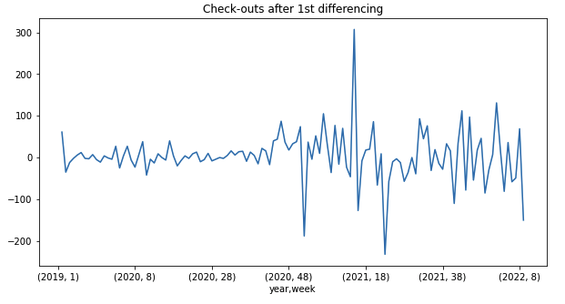
Differencing

Slide 36
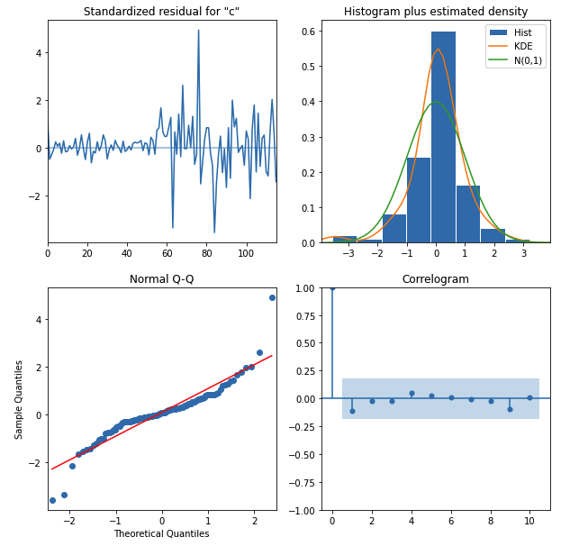
ARIMA(2,1,2) diagnostics

Slide 37
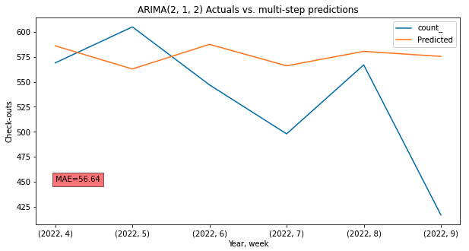
ARIMA(2,1,2) predictions

Slide 38
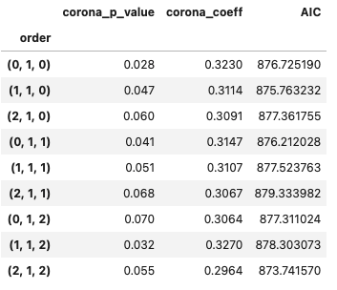
Corona contribution to ARIMA

Slide 39
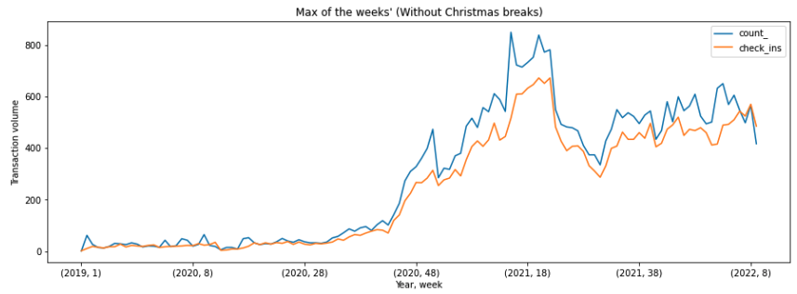
Check-in & check-out interaction (Last internal dependency)

Slide 40
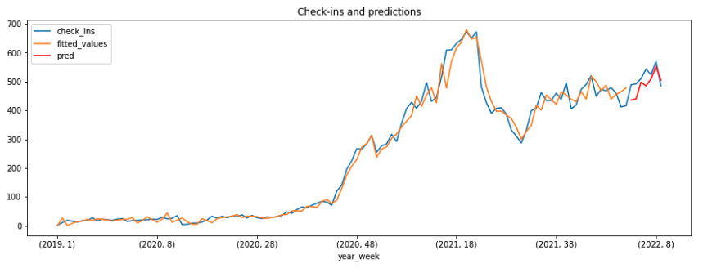
Check-in prediction with the exogenous variable SARIMAX (1,1,0)

Slide 41
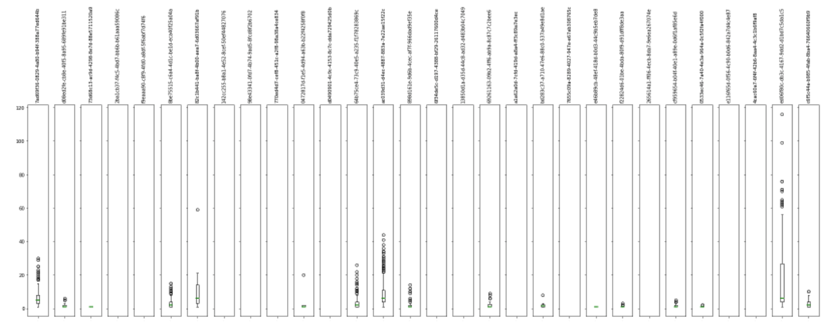
Randomly selected stores

Slide 42
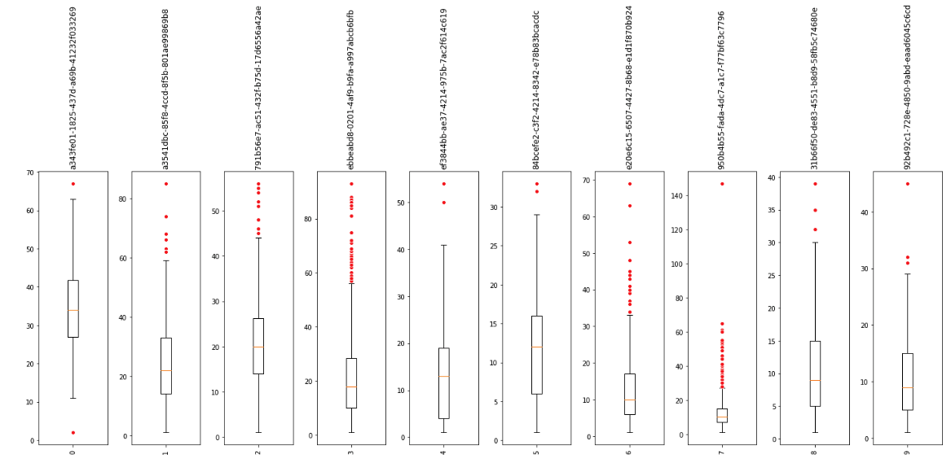
Top 10 stores

Slide 43
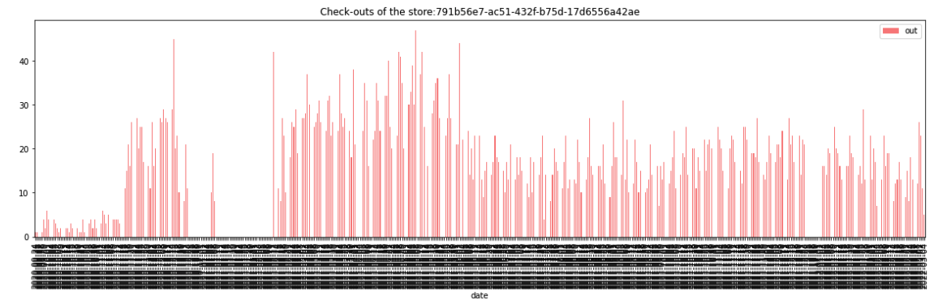
Check-outs of the selected store

Slide 44
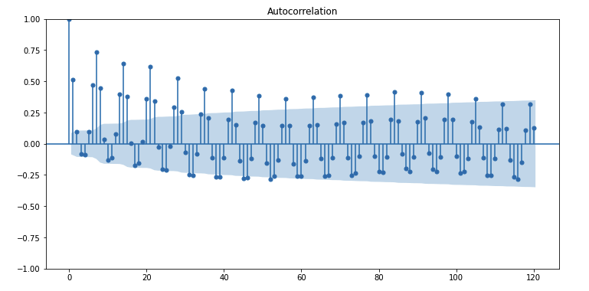
Selected store Autocorrelation
Notes:
Weekly seasonality is evident.

Slide 45
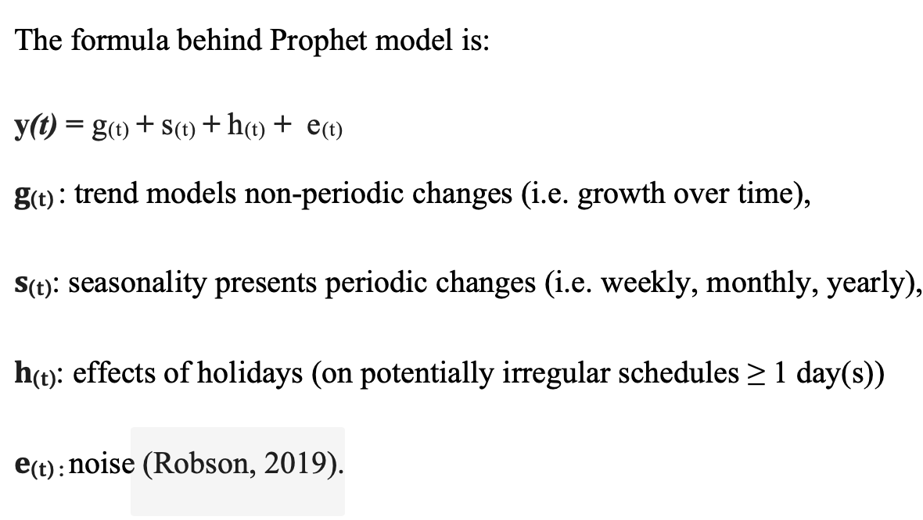
Prophet

Slide 46
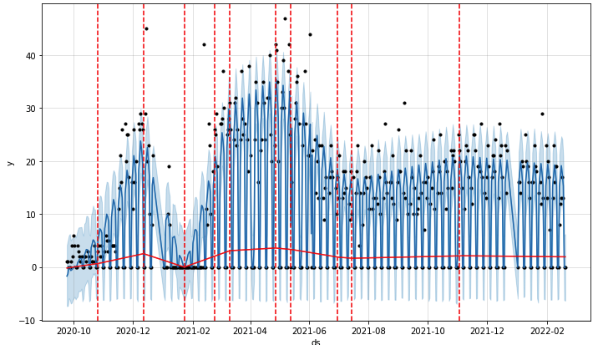
Prophet model change points
Notes:
Change points refer the start and end of each trend portion.

Slide 47
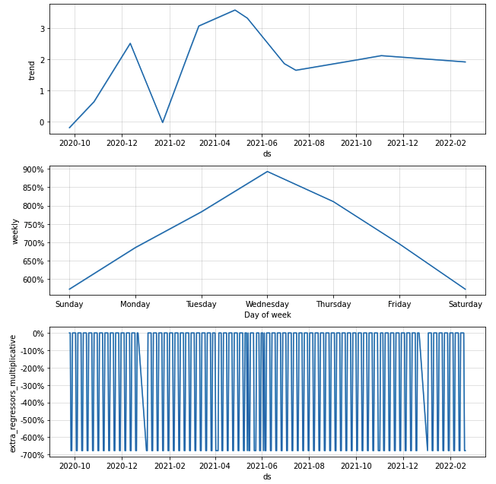
Prophet diagnostics
Notes:
Trend, seasonality and regressor (is_holiday). The contribution of those can be tuned with hyper-parameters.

Slide 48

Prophet prediction
Notes:
If we know the extreme changes, we can model them as well.

Slide 49
Conclusion and recommendations
Association between container type 4 and 8 can be ignored.
Although spatial autocorrelation shows some indications for such a correlation, the local autocorrelation and the graphical analysis does not justify a significant correlation with the check-out sizes.
Corona cases is not relevant anymore, although we found out some correlation with the check-outs.

Slide 50
Conclusion and recommendations
Daily and weekly seasonality are evident.
Yearly seasonality should be monitored in the future.
ARIMA and prophet models were implemented for long and short-term planning horizons.
Prophet was preffered over ARIMA because of its scalability.
Daily aggregation was taken in this thesis. However, intraday granularity can be also interesting for future studies.
Consumer prespective regarding the predictions can also be interesting for future studies.
The noise in the series can be explained better and then modelled as more data is collected, i.e. data from consumers or stores, e.g. daily routine of a customer or available seats in a store.

Slide 51
Bibliography
Deuscher Wetterdienst. (2022). Open data. Retrieved 5 5, 2022 from https://opendata.dwd.de/
DIVA-GIS. (2022). Download data by country. Retrieved 5 16, 2022 from http://www.diva-gis.org/gdata
Glen, S. (2016). Statistics How To. Retrieved 6 1, 2022 from https://www.statisticshowto.com/morans-i/#:~:text=The%20Moran's%20statistic%20is%20calculated,%CC%84y)2)%2Fn
Offene Daten Köln. (2022, 5 5). Grüne Flächen. Retrieved 1 1, 4 from Grüne Flächen: https://offenedaten-koeln.de/dataset/gruenflaechenkataster-koeln-flaechentypen
Peixeiro, M. (2022). Time Series Forecasting in Python (1st Edition ed.). New York: Manning.
Rafferty, G. (2021). Forecasting Data Time Series Data with Facebook Prophet (1st Edition ed.). Mumbai: Pack.
Robert Koch Institute. (2022, 4 4). SARS-CoV-2_Infektionen_in_Deutschland. Retrieved 3 1, 2022 from GitHub: https://github.com/robert-koch-institut/SARS-CoV-2_Infektionen_in_Deutschland
rspatial.org. (2022). Spatial Data Science. Retrieved 5 18, 2022 from https://rspatial.org/raster/analysis/3-spauto.html
Robson, W. (2019). The Math of Prophet. Retrieved 2 2, 2023 from https://medium.com/future-vision/the-math-of-prophet-46864fa9c55a
Stadt-Köln. (2022, 4 1). Veranstaltungen. Retrieved 3 2, 2022 from Veranstaltungen: https://www.stadt-koeln.de/leben-in-koeln/veranstaltungen
Tan, P.-N., Steinbach, M., Karpatne, A., & Kumar, V. (2020). Introduction to Data Mining (2nd Edition Global Edition ed.). New York: Pearson.
Verkehrsverbund-Rhein-Sieg. (2022, 5 1). OpenData / OpenService. Retrieved 2 2, 2022 from https://www.vrs.de/fahren/fahrplanauskunft/opendata-/-openservice
Vytal. (2022, 5 5). Home Page. Retrieved 1 15, 2022 from https://en.vytal.org/

